Slide 1
DEPARTMENT OF SOCIOLOGY
GOVERNMENT CHANDULAL CHANDRAKAR ARTS AND SCIENCE COLLEGE PATAN,
DIST. –DURG (C.G.)
Welcomes Peer NAAC Review Teem Visit on 15`th -16`th September 2021

Slide 2
vuqdzef.kdk
1. n`f’V
2. mn~ns”;
3- foHkkxh; tkudkjh
4- fof”k’Vhdj.k ,oa vuqHko
5- vkxkeh iapo’khZ; dk;Z ;kstuk
6- izkoh.; lwph
7- ewY;kadu i)fr
8- izosf”kr fo|kfFkZ;ksa dh la[;k
9- ijh{kkfFkZ;ksa dh la[;k
10- ijh{kk ifj.kke
11- ijh{kk ifj.kke fo”ys’k.k
12- foHkkx dh xfrfof/k;kW

Slide 3
n`f’V ( Vision)
fo|kfFkZ;ksa esa uSfrd ,oa ewY; vk/kkfjr f”k{kk ds ek/;e ls O;fDRkRo dk lokZaxh.k fodkl dj oSf”od lekt dks Js’B O;fDr lkSaiukA
To confer the society the best person by having developed the multidimensional personality of students through the moral and value based education.

Slide 4
mn~ns”; (Mission)
fo|kfFkZ;ksa dks O;fDr ,oa lekt ds vUr%laca/kksa dh izxk<+rk dk egRo crykukA
lekftd ?kVukvksa ds ifjisz{; esa fo|kfFkZ;ksa esa voyksdukFkZ n`f’V fodflr djukA
oSKkfud vf/kxe iz.kkyh ds ek/;e ls fo|kfFkZ;ksa dks lkekftd leL;kvksa ds lanHkZ esa vuqla/kku gsrq izksRlkfgr djukA
Hkkjrh; laLd`fr dh ijEijkxr ekU;rkvksa ls ifjfpr djokrs gq, fo|kfFkZ;ksa esa lkekftd ewY;ksa ds izfr vkLFkk j[kus ,oa mudh Lo;a dh lkekftd igpku dks izfrf’Br djus gsrq mUgsa izsfjr djukA
To tell students the significance of the solidarity of inter-relation between an individual and the society
To develop the observational view in students in view of social happenings.
To motivate students for doing research on social problems through the scientific learning methods.
To motivate students to have trust for social values and establish their own social identity by introducing the traditional beliefs of Indian culture to them.

Slide 5
foHkkxh; tkudkjh
lekt”kkL=
“kkldh; pUnwyky pUnzkdj dyk ,oa foKku egkfo|ky;] ikVu dh LFkkiuk o’kZ 16 vxLr 1989 esa gqbZA blh o’kZ ls bl egkfo|ky; esa Lukrd Lrj ij lekt”kkL= fo’k; izkjaHk fd;k x;kA bl vapy ds yxHkx 80 izfr”kr fo|kFkhZ lekt”kkL= fo’k; dk p;u dj Lukrd fMxzh izkIr djrs gSaA
LukrdksRrj Lrj ij lekt”kkL= fo’k; l= 1997&98 ls izkjaHk fd;k x;kA orZeku esa fo-fo- }kjk vuqeksfnr leLr 20 lhVksa ij fo|kFkhZ izosf”kr gSaA
Lohd`r in
in | Lohd`r | Hkjs x;s in
izk/;kid | 01 | 01
lgk;d izk/;kid | 01 | 01

Slide 6
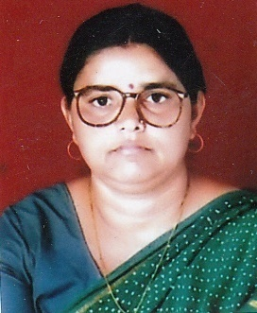
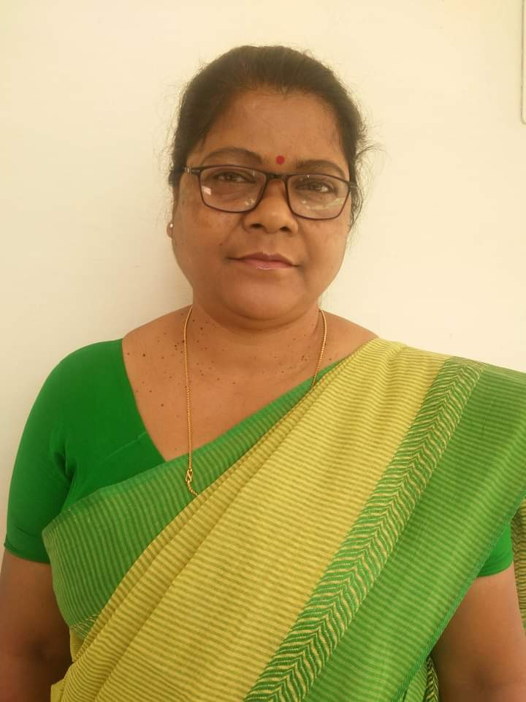
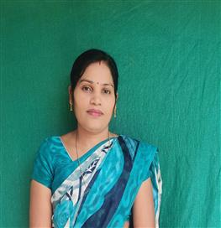
dz- | uke | in | “kS{kf.kd ;ksX;rk | izHkkj
1 | MkW- “kksHkk JhokLro ¼foHkkxk/;{k½ | izk/;kid | ,e-,-] ih ,p&Mh- | izHkkjh izkpk;Z
2 | MkW- iq’ik feat | lgk;d izk/;kid | ,e-,-] ih ,p&Mh- | dk;Zdze vf/kdkjh jk-ls-;ks- bdkbZ &02] lnL; lkaLd`frd ,oa ;qok mRlo lfefr] izHkkjh jk-ls-;ks- mn~;ku] lnL; HkwriwoZ Nk= lfefr] lnL; ijh{kk lfefr
3- | Jherh izHkk oekZ | t-Hkk- lgk- izk/;kid | ,e-,-] ,e- fQy ]usV | &
izHkkjh izkpk;Z MkW- iq’ik feat Jherh izHkk oekZ
MkW- “kksHkk JhokLro lgk;d izk/;kid t-Hkk-lgk;d izk/;kid

Slide 7
fof”k’Vhdj.k ,oa vuqHko
Ukke | f”k{kk | Ikn | fof”k’Vhdj.k | v/;kiu vuqHko | ih ,p- Mh- “kks/k Nk= la[;k
MkW-”kksHkk JhokLro | ,e- ,- ih ,p- Mh- | izk/;kid | vkS|ksfxd lekt”kkL+= | 36 o’kZ | 02 Nk=ksa dk “kks/k dk;Z py jgk gSa
MkW- iq’ik feat | ,e-,- ih ,p- Mh- | lgk;d izk/;kid | xzkeh.k lekt”kkL= | 27 o’kZ | &

Slide 8
vkxkeh iapo’khZ; dk;Z ;kstuk
“kks/k dsUnz dh LFkkiuk gsrq iz;klA
fo|kfFkZ;ksa }kjk LFkkuh;] {ks=h; dk;ksZa ij vk/kkfjr ifj;kstukvksa dks “kks/k dk;Z dh mikf/k gsrq #ikarfjr djus ds fy, izsfjr djukA
v/;;u ds i”pkr Hkkjrh; laLd`fr vkSj lekt dh ekSfyd igpku dk laj{k.k ,oa lekt lsok ds {ks= esa lfdz; lgHkkfxrk gsrq fo|kfFkZ;ksa dks izsfjr djukA

Slide 9
izkoh.; lwph
dz- | Nk=@Nk=k dk uke | izkoh.; lwph esa LFkku | o’kZ
1 | ykds”k dqekj | lkrokW | 2009
2 | pUnz”ks[kj d”;i | ikpokW | 2011
3 | dq- oanuk nsokaxu | izFke | 2015
4 | dq- jks”kuh pUnzkdj | f}rh; | 2015
5 | dq- iwtk | f}rh; | 2015
6 | jktw yky | prqFkZ | 2016
7 | dq- ek/kqjh caNksj | izFke | 2018
8 | dq- dYiUkk oekZ | r`rh; | 2018
9 | dq- ikoZrh Bkdqj | lkrokW | 2018
10 | dq- frykspuh | f}rh; | 2019
11 | dq- fgrs”ojh | prqFkZ | 2019
12 | dq- Lokrh | vkBokW | 2019

Slide 10
ewY;kadu i)fr
egkfo|ky; }kjk Nk=ksa ds ewY;kadu gsrq ijh{kk yh tkrh gSA
Lukrd Lrj %&
=Sekfld ijh{kk % fo”ofo|ky; ds vdknfed dSys.Mj ds vuqlkj vFkkZr flrEcj ekg ds izFke lIrkg esa =Sekfld ijh{kk dk vk;kstu fd;k tkrk gSA
ekWMy ijh{kk % Nk=ksa esa izfrLi/kkZRed okrkoj.k fufeZr djus ds mn~ns”; ls ekWMy ijh{kk dk vk;kstu ekg tuojh ds izFke o f}rh; lIrkg esa fd;k tkrk gSA
LukrdksRrj Lrj %&
vkarfjd ijh{kk % ,e-,- ds Nk=ksa dh vkarfjd ijh{kk yh tkrh gSA ,d lsesLVj esa nks ckj vkarfjd ijh{kk dk vk;kstu fd;k tkrk gSA
osfcukj@lsehukj % Nk=ksa esa vius fopkj izLrqr djus dh dyk esa fuiq.krk ykus ds mn~ns”; ls le;&le; ij fo’k;d ¼ikB~;Øe½ ls lacaf/kr osfcukj@lsehukj dk vk;kstu fd;k tkrk gSA PPT }kjk Hkh izLrqrhdj.k fd;k tkrk gSA

Slide 11
Lukrd ijh{kk ifj.kke
l= | d{kk | izosf”kr | ijh{kkFkhZ | ifj.kke | izfr”kr
2015&16 | ch-,- Hkkx & ,d | 203 | 203 | 99 | 48-76
 | ch-,- Hkkx & nks | 143 | 143 | 140 | 97-90
 | ch-,- Hkkx & rhu | 83 | 83 | 83 | 100
2016&17 | ch-,- Hkkx & ,d | 201 | 201 | 192 | 95-52
 | ch-,- Hkkx & nks | 112 | 112 | 111 | 99-10
 | ch-,- Hkkx & rhu | 60 | 60 | 60 | 100
2017&18 | ch-,- Hkkx & ,d | 210 | 200 | 190 | 95-50
 | ch-,- Hkkx & nks | 197 | 193 | 184 | 95-33
 | ch-,- Hkkx & rhu | 211 | 188 | 159 | 84-57
2018&19 | ch-,- Hkkx & ,d | 226 | 213 | 201 | 94-36
 | ch-,- Hkkx & nks | 222 | 215 | 202 | 93-95
 | ch-,- Hkkx & rhu | 235 | 233 | 233 | 100
2019&20 | ch-,- Hkkx & ,d | 213 | 213 | 213 | 100
 | ch-,- Hkkx & nks | 228 | 228 | 228 | 100
 | ch-,- Hkkx & rhu | 196 | 196 | 196 | 100

Slide 12
LukrdksRRkj ijh{kk ifj.kke
l= | d{kk | izosf”kr | ijh{kkFkhZ | ifj.kke | izfr”kr
2015&16 | ,e- ,- f}rh; lsesLVj | 16 | 16 | 16 | 100
 | ,e- ,- prqFkZ lsesLVj | 13 | 13 | 13 | 100
2016&17 | ,e- ,- f}rh; lsesLVj | 19 | 16 | 16 | 100
 | ,e- ,- prqFkZ lsesLVj | 14 | 14 | 09 | 63
2017&18 | ,e- ,- f}rh; lsesLVj | 18 | 14 | 14 | 100
 | ,e- ,- prqFkZ lsesLVj | 16 | 16 | 16 | 100
2018&19 | ,e- ,- f}rh; lsesLVj | 20 | 20 | 20 | 100
 | ,e- ,- prqFkZ lsesLVj | 14 | 14 | 14 | 100
2019&20 | ,e- ,- f}rh; lsesLVj | 20 | 18 | 18 | 100
 | ,e- ,- prqFkZ lsesLVj | 20 | 18 | 17 | 99-10

Slide 13
MkW- “kksHkk JhokLro
dk;Z o`rkar
01- uke % MkW “kksHkk JhokLro
02- tUefrfFk % 09@04@1960
03- firk dk uke % Lo- ukjk;.k izrki JhokLro
04- ekrk dk uke % Lo- txnEck JhokLro
05- f”k{kk % ch-,-] ch-,M-] ,e-,-& lekt”kkL= ¼izkoh.; lwph f}rh; LFkku½
ih-,p-Mh-] vxLr 2001] ^^:X.k lkoZtfud midze esa deZpkfj;ksa dh
leL;k,a ,oa vis{kkvksa dk ,d lekt”kkL=h; v/;;u**
fo”ks’k lUnHkZ% ¼fgUnqLrku LVhy oDlZ daLVªD”ku fyfeVsM fHkykbZ½
06- in % lgk;d izk/;kid ¼lekt”kkL= ½ 12@09+@1983
07- inksUufr % izk/;kid 2006] izHkkjh izkpk;Z ds :i esa dk;Zjr ekpZ 2018 ls
08- dk;Zjr laLFkk dk fooj.k&
I. “kkldh; egkfo|ky; do/kkZ & 12@09@1983 & 13@08@1987
II. “kkldh; egkfo|ky; csesrjk & 1987 & 1990
III. “kkldh; egkfo|ky; “kadjuxj] jk;iqj & 1990 & 1998
IV. “kkldh; egkfo|ky; jkfte & 1998 & 2008
V. “kkldh; egkfo|ky; ikVu] nqxZ & 2008 ls fujarj
09- “kks/k funsZ”kd dh ekU;rk % lekt”kkL= lkekftd foKku fnlEcj 2013
10- “kks/k funsZ”kd esa iathd`r Nk= la[;k % 01 $ 01

Slide 14
11- foRrh; izHkkj % vkgj.k laforj.k] foRrh; vf/kdkj
a. fnukad twu 2018
b. fnukad vizSy 2018
12- dsUnzh; v/;;u e.My % lkekftd foKku ladk; lekt”kkL= ¼34,¼2½¼I½ dsUnzh; v/;;u e.My lnL;
13- v/;;u e.My v/;{k % gsepan ;kno fo”ofo|ky; nqxZ
a. Lkekftd foKku ladk; lekt”kkL= v/;;u e.My v/;{k 2017
b. v/;;u e.My lnL; ch-,-] ch-,M-, fnlEcj 2017
14- fo/kk ifj’kn lnL; % gsepan ;kno fo”ofo|ky; nqxZ fo/kk ifj’kn lnL; tuojh 2018
15- ijh{kk lfefr lnL; % gsepan ;kno fo”ofo|ky; nqxZ ijh{kk lfefr fnukad 2017&18
16- lkekftd foKku ladk; lfefr % gsepan ;kno fo”ofo|ky; nqxZ lkekftd foKku ladk; lnL;
lnL; fnukad tqykbZ 2018
17- okf.kT; ladk; lfefr lnL; % gsepan ;kno fo”ofo|ky; nqxZ lkekftd foKku ladk; lnL; fnukad tqykbZ 2018
18- “kks/k dk;Z dh ekU;rk gsrq % gsepan ;kno fo”ofo|ky; nqxZ “kks/k dk;Z dh ekU;rk gsrq
fujh{k.k lfefr dk xBu fujh{k.k fnukad tuojh 2019
19- egkfo|ky; ds “kklh fudk; % fHkykbZ uk;j lekte dkWyst] fHkykbZ] vxLr 2018
fo”ofo|ky; ds izfrfuf/k
gsepan ;kno fo”ofo|ky; nqxZ

Slide 15
20- dY;k.k Lo”kklh LukrdksRrj % vkdnfed l= 2017&2018] 2018&2019
egkfo|ky;] fHkykbZ uxj nqxZ lekt”kkL= Lukrd o LukrdksRrj ikB~;dzeksa ds v/;;u
v/;;u e.My lnL; e.My lnL;] vDVwcj 2017
21- tuHkkxhnkjh izca/ku lfefr gsrq % “kkldh; nkuohj rqykjke LukrdksRrj egkfo|ky;]
fo”ofo|ky; }kjk euksuhr mrbZ] ftyk nqxZ ¼N-x-½
lnL; ¼02 o’kksZa ds fy,½ uoEcj 2020
22- ladk;k/;{k % gsepan ;kno fo”ofo|ky; nqxZ ¼N-x-½
¼dqykf/kifr egksn; }kjk½ lkekftd foKku
23- fo|k ifj’kn % gsepan ;kno fo”ofo|ky; nqxZ fo|k ifj’kn lnL;
tuojh 2021
24- NRrhlx<+ yksd lsok vk;ksx % ijh{kk ls lEcaf/kr xksiuh; dk;Z
jk;iqj “kadj uxj jksM a. fnukad 28@01@2016 & 05@12@2016
b. fnukad 25@10@2017 & 31@10@2017
c. lk{kkRdkj lekt”kkL+= 24@06@2017] 27@06@2017] 28@06@2017
d. ijh{kk xksiuh; dk;Z 05@09@2018 & 11@09@2018

Slide 16
25- egkfo|ky; izkjEHk djokus gsrq % a. gksfyfLVd QkmaMs”ku fHkykbZ] xzke pan[kqjh] ftyk nqxZ
fujh{k.k lfefr] vk;qDr mPp ih-th-Mh-lh-,-] Mh-lh-,- ch-dkWe-] ch-,-] ch-,l-lh-
f”k{kk foHkkx }kjk ¼xf.kr o ck;ks ½
b. N=ifr f”kokth egkfo|ky;] dksfygkiqjh] nqxZ
ih-th-Mh-lh-,-] Mh-lh-,-] ch-,l-lh- ¼vkbZ-Vh-½
ch-,l-lh- ¼dEI;wVj½
c. NRrhlx<+ dkWyst /kuksjk] nqxZ
ih-th-Mh-lh-,-] ch-lh-,-] ch-,l-lh-] ch-dkWe-] ch-ch-,-
d. jkuhrjkbZ rglhu ikVu] nqxZ
ch-,-] ch-,l-lh-] ch-dkWe-
26- lEc)rk lfefr % a. gsepan ;kno fo”ofo|ky; nqxZ
MSW ekLVj vkWQ lks”ky odZ 21@02@2019
b. :axVk foKku o rduhdh egkfo|ky;] xatikjk] nqxZ
ch-,l-lh-] ch-dkWe- fnukad 06@01@2020
c. eulk f”k{kk egkfo|ky; dksgdk jksM] fHkykbZ
ch-,- izHke o’kZ ¼lekt”kkL=] jktuhfr “kkL=] bfrgkl½
ch- dkWe-¼dEI;wVj ,Iyhds”ku½] ch-,l-lh- ¼xf.kr o
dEI;wVj lkbal½

Slide 17
27- vfrfFk oDrk % a. ^^LoLF; Hkkjr ds fy, LoLF; ;qok] 08@12@2016 xzke lksuiqj] rglhy ikVu
b. ^^Hkkjr esa foeqnzhdj.k**] 17@01@2017
vk;ZHkV~V dyk ,oa foKku egkfo|ky; dksijk] xfj;kcan] jk;iqj
c. ^^O;fDrRo fodkl**] 16@12@2019 “kSy nsoh egkfo|ky;
d. ^^Lokeh foosdkuan O;fDrRo o d`frRo 12@01@2018 uxj iapk;r ] ikVu
28- “kks/k vkys[k % “kks/k laizs’k.k 05
fo/kk okrkZ 05
“kks/k ladYi 01
fjlpZ fyad 01
ds- ch- ,l- izdk”ku 01
29- jk’Vªh; lsehukj dh la[;k
30- ckg~; izk;ksfxd ijh{kd
31- iz”u i= fuekZ.k dk;Z % a. dY;k.k LukrdksRrj egkfo|ky;] fHkykbZ uxj
b. ts- ;ksxukUne NRrhlx<+ egkfo|ky;] jk;iqj
c. iafMr jfo”kadj “kqDy fo”ofo|ky;] jk;iqj
32- izHkkjh izkpk;Z izf”k{k.k dk;Zdze % ifjp;kRed izf”k{k.k dk;Zdze

Slide 18
iathd`r “kks/k Nk=k

Slide 19
lekt”kkL= foHkkx dh xfrfof/k;kW
PPT }kjk izLrqrhdj.k

Slide 20
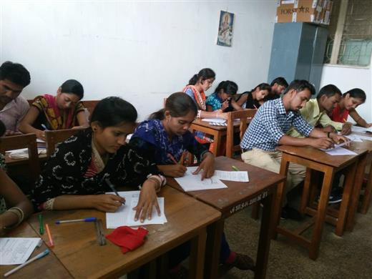
vkarfjd ijh{kk

Slide 21
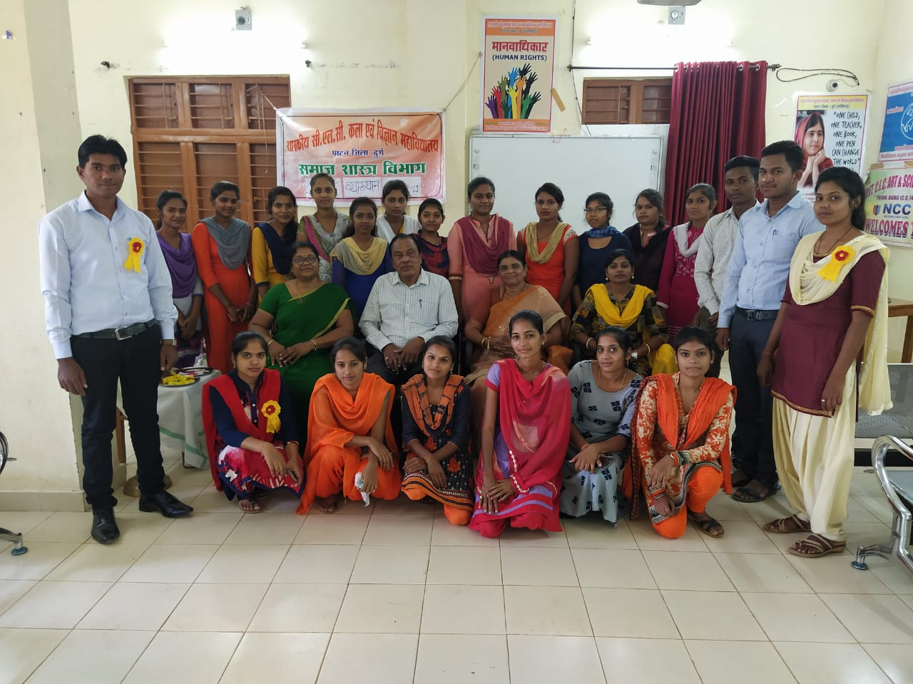
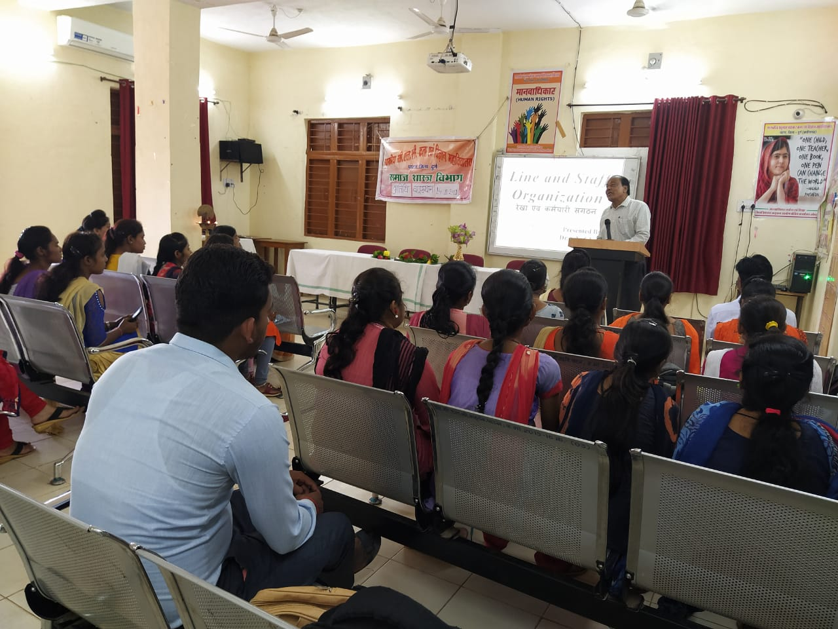
,e-,- esa vfrfFk O;k[;ku MkW-,l-,u- ?kks’k }kjk

Slide 22
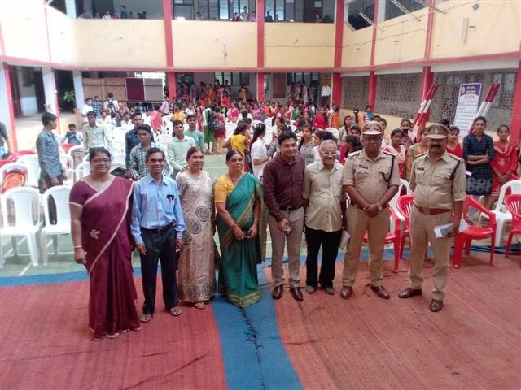
lkbcj tkx`fr dk;Zdze

Slide 23
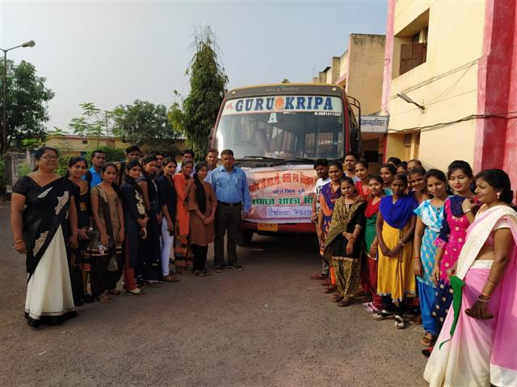
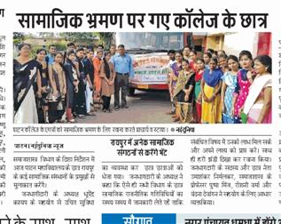
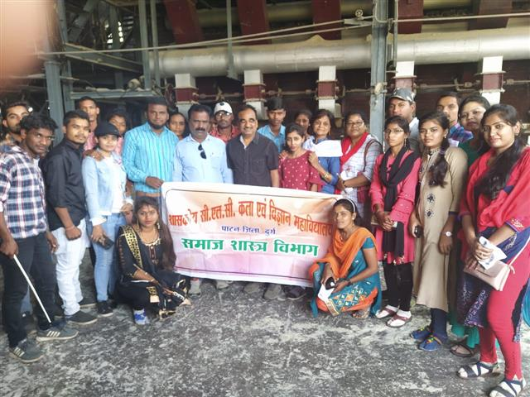
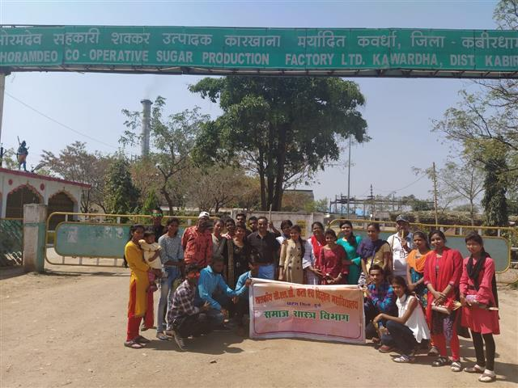
“kS{kf.kd Hkze.k

Slide 24
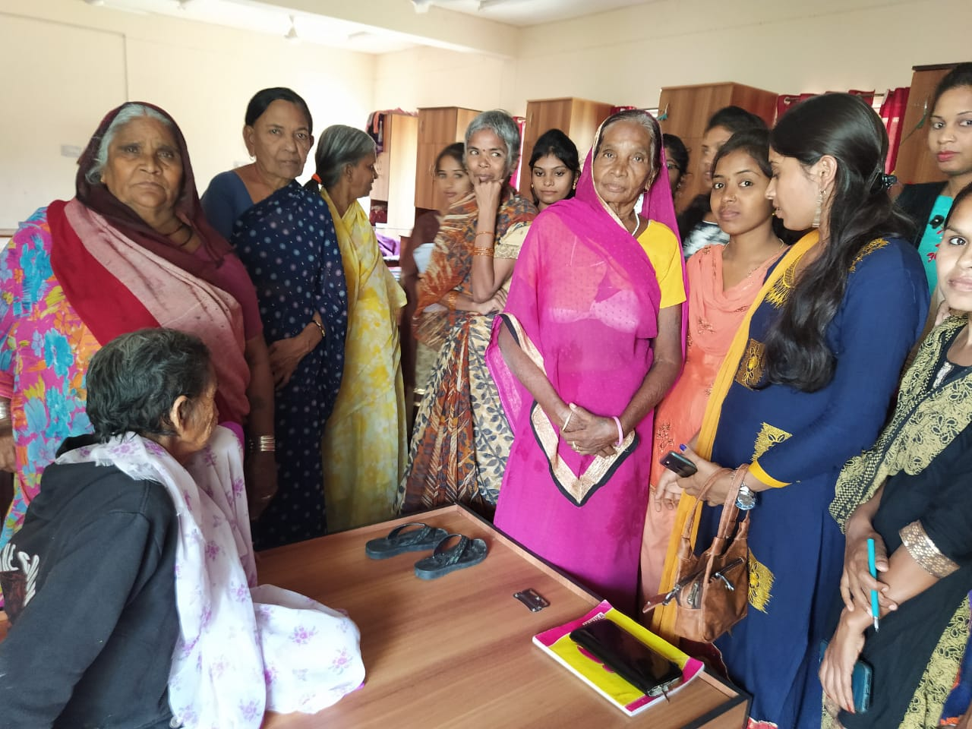
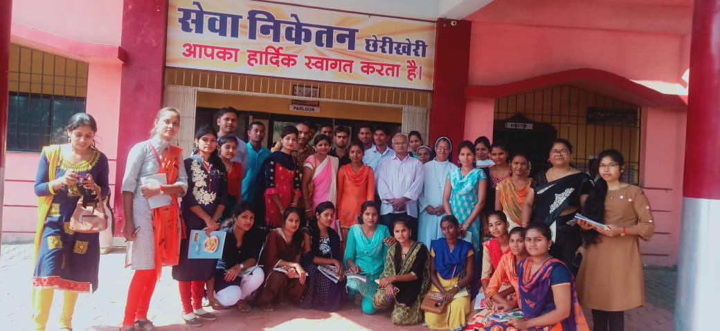
“kS{kf.kd Hkze.k

Slide 25
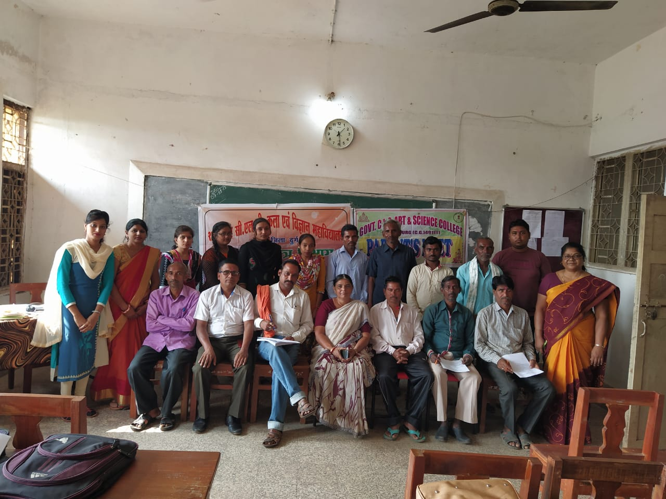
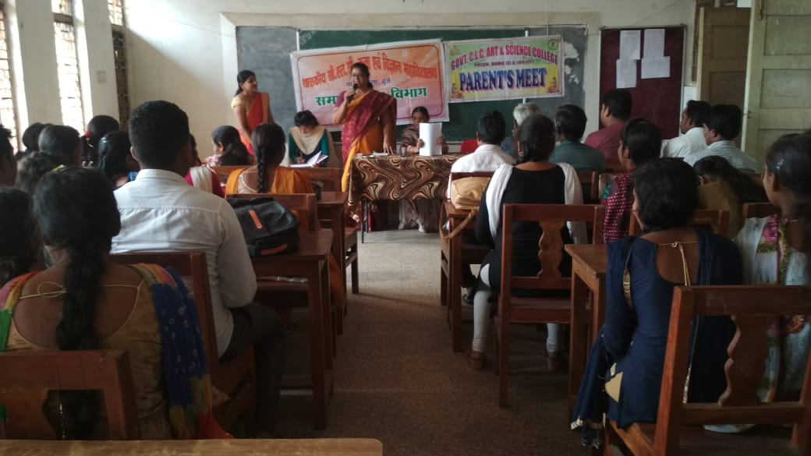
vfHkHkkod cSBd

Slide 26
/kU;okn

